Slide 1
WORLD OF DRONE
Drone Application: Anti-poaching

Slide 2
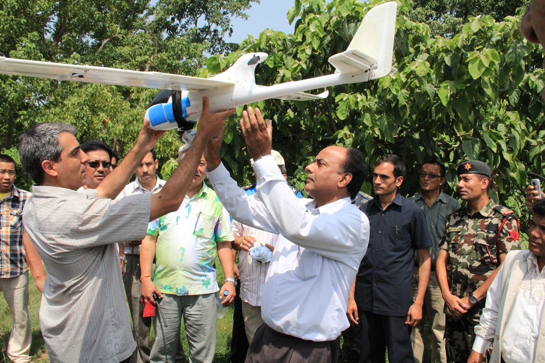
?
Drone Application: Anti-poaching
In June 2012, World Wide Fund for Nature (WWF) announced it would begin using UAVs in Nepal to aid conservation efforts.

Slide 3
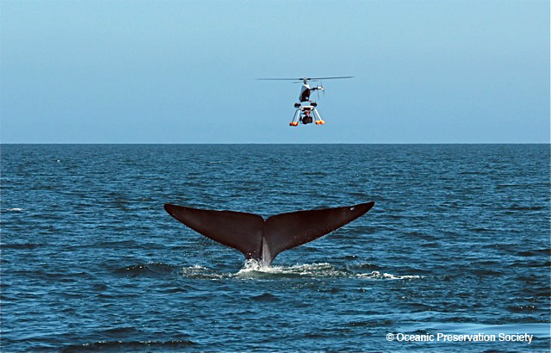
?
Drone Application: Anti-poaching
- In August 2012, UAVs were used by members of the Sea Shepherd Conservation Society in Namibia to document the annual seal cull.

Slide 4
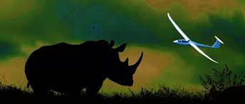
?
Drone Application: Anti-poaching
In December 2013, the Falcon UAV was selected by the Namibian Government and WWF to help combat rhinocerous poaching.

Slide 5
?
Drone Application: Anti-poaching
In 2012, the WWFund supplied two FPV Raptor 1.6 UAVs to Nepal National Parks. These UAVs were used to monitor rhinos, tigers and elephants and deter poachers. The UAVs were equipped with time-lapse cameras and could fly for 18 miles at 650 feet.

Slide 6
?
Drone Application: Anti-poaching
In March 2013, UAV conservation nonprofit ShadowView, founded by former members of Sea Shepherd Conservation Society, worked with anti-hunting charity the League Against Cruel Sports to expose illegal fox hunting in the UK.

